Slide 1
6LY CR-SCR specification Data sheet
01/12/2023

Slide 2
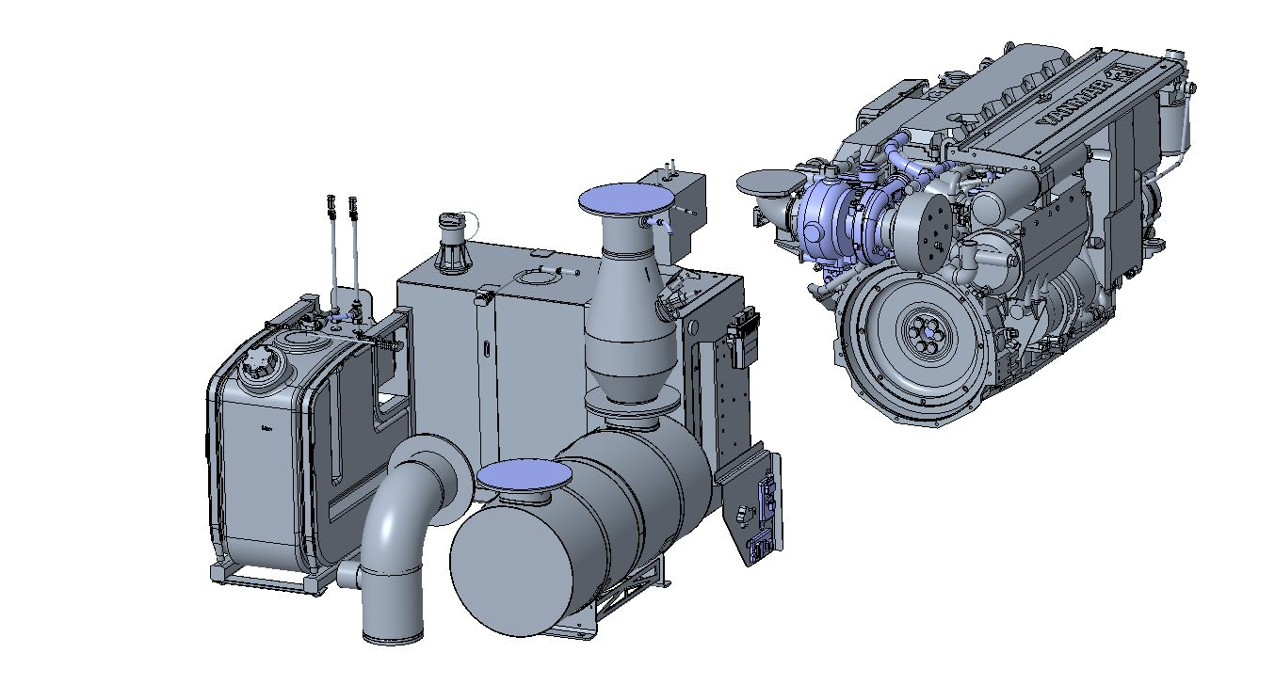
Yanmar IMO teir III solution
6LY CR x SCR
Yanmar's IMO Tier III solution epitomizes excellence, harnessing the power of the compact, lightweight, and robust 6LY common rail 6-cylinder in-line engine, available in 400 and 440 mHp variants. Crafted with precision in-house, this integrated system incorporates an advanced Selective Catalytic Reduction (SCR) system, meticulously designed to comply with the latest MARPOL IMO III regulations.
Our Tier III solution is a testament to Yanmar's commitment to delivering the highest quality. It has undergone thorough certification by DNV, ensuring that it not only meets but exceeds industry standards.
150L Adblue Tank
50L Adblue Tank
SCR unit
Optional mixing elbow

Slide 3
Technical Data
6LY CR x SCR
Item | Operating parameter/ requirements /specs
Engine | Yanmar 6LY CR
Supported power range | 6LY400 | 6LY440
Max output at cranckshaft (kW) | 294 kW@3300 rpm | 324kW@3300 rpm
Fuel | Max allowable sulfur content 500 ppm. EN590 & ASTM D975.
Weight (Engine+SCR) (kg) | 668 kg (DEF Tank not included)
SCR Operation Conditions (Exhaust temperatures °C) | Texh min = 220°C is the min exhaust gas temp at the inlet of the SCR chamber for reductant injection. Texh max = 600°C is the max exhaust gas temp at the inlet of the SCR chamber.
Max exhaust back pressure (kPa) | Pmax = pressure 30 kPa.
Power supply requirements (Vdc) | 24Vdc. 24Vdc, Tamb ≤ -12°C.
SCR chambers and catalyst | The SCR unit: 4x Ø13” x 4” catalysts, arranged as 2x HTS4 catalysts and 2x HTS3 catalysts.

Slide 4
Technical Data
6LY CR x SCR
Item | Operating parameter/ requirements /specs
Reductant | Diesel Exhaust Fluid (DEF) 32.5%. According to AUS32 and ISO 22241. Consumption : at max load 3%.
Exhaust emission Compliance limit (g/kWh) | 0.42/2.0 g/kWh
Reductant injection system | DEF Injector
 | DEF Pump
 | SCR ECU
Adblue tank | 50L DEF Tank (plastic) (10kg)
 | 150L DEF Tank (SS) (71.5kg)
NOx sensors | Smart NOx Sensor
Temperature sensor | Measures SCR inlet exhaust gas temperature
Back pressure sensor | Measures exhaust gas back pressure

Slide 5
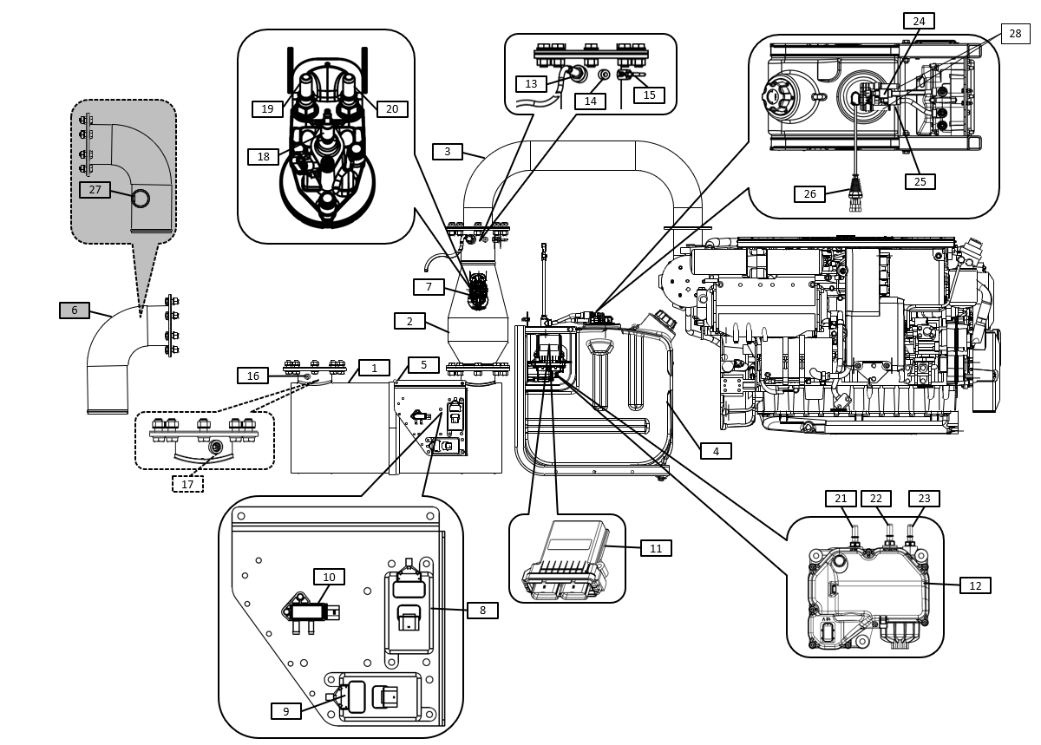
System overview
6LY CR x SCR

Slide 6
6LY CR x SCR
System overview
1- Catalyst | 11- SCR ECU | 21- Inlet
2- Mixer | 12- Adblue pump | 22- Backflow
3- Exhaust duct pipe (not included) | 13- Inlet NOx sensor | 23- Outlet
4- Adblue tank | 14- Backpressure sensor inlet 1 | 24- Adblue Backflow port
5- Sensor's bracket | 15- Temperature sensor | 25- Adblue feed port
6- Mixing elbow (optional) | 16- Backpressure sensor inlet 2 | 26- Connector SCR ECU
7- Adblue injector | 17- Outlet NOx sensor | 27- Sea water connection
8- NOx sensor 1 | 18- Interface Adblue connector | 28- heating inlet/outlet
9- NOx sensor 2 | 19- Interface coolant connector
10- Differential back pressure sensor | 20- Interface coolant connector
Front side
Back side
Optional

